Slide 1
Software Testing
Final - Swebok

Slide 2
Svarbios temos
Testų kūrimas
Tinkamų testavimo veiklų (testų parinkimas)
Kokybės įvertinimas

Slide 3
SWEBOK
Software Engineering Body of Knowledge:
Software requirements
Software design
Software construction
Software testing
Software maintenance
Software configuration management
Software engineering management
Software engineering process
Software engineering models and methods
Software quality
Software engineering professional practice
Software engineering economics
Computing foundations
Mathematical foundations
Engineering foundations

Slide 4
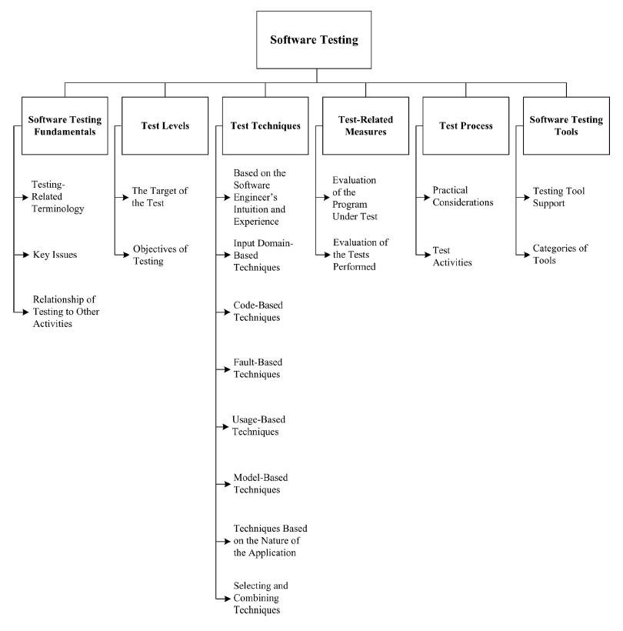

Slide 5
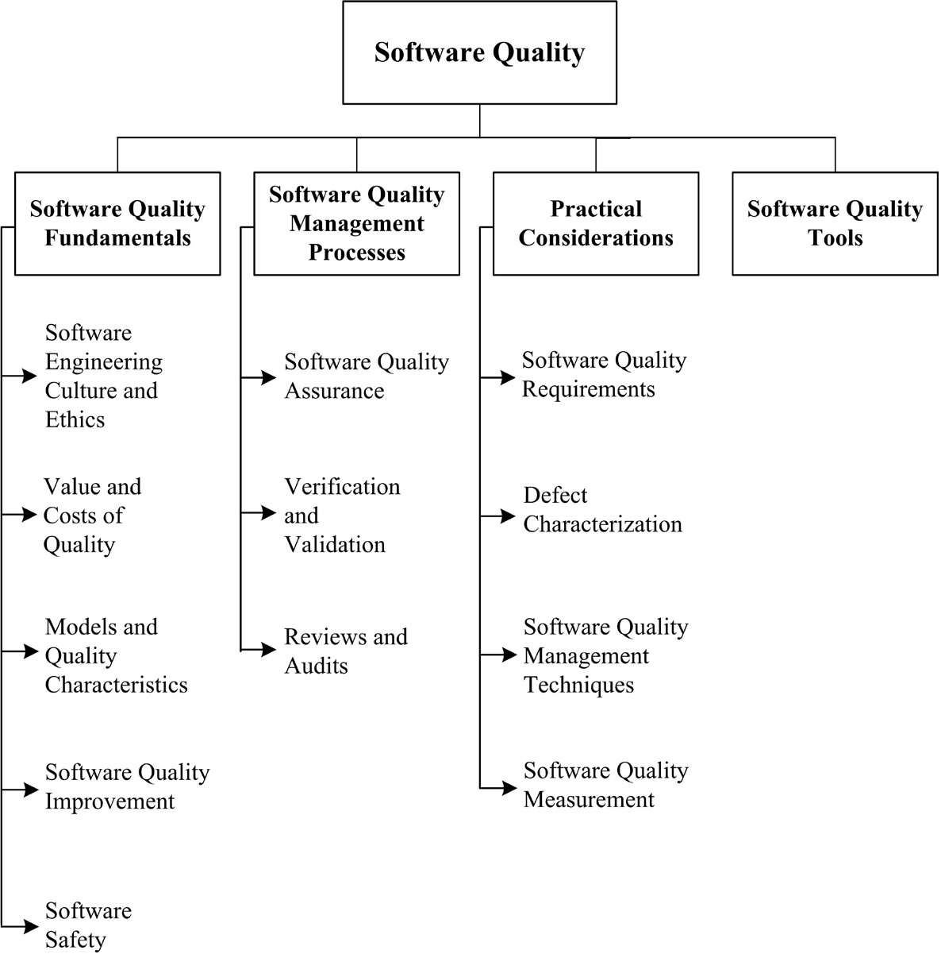

Slide 6
References
http://swebokwiki.org

Slide 7
Q/A s.v.p.

